Slide 1
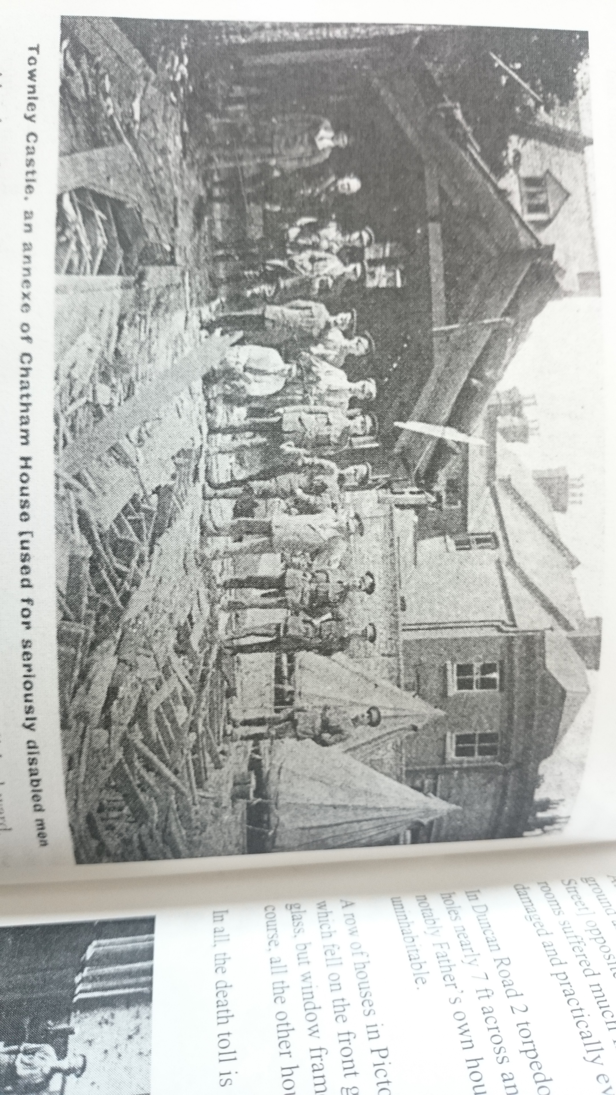

Slide 2
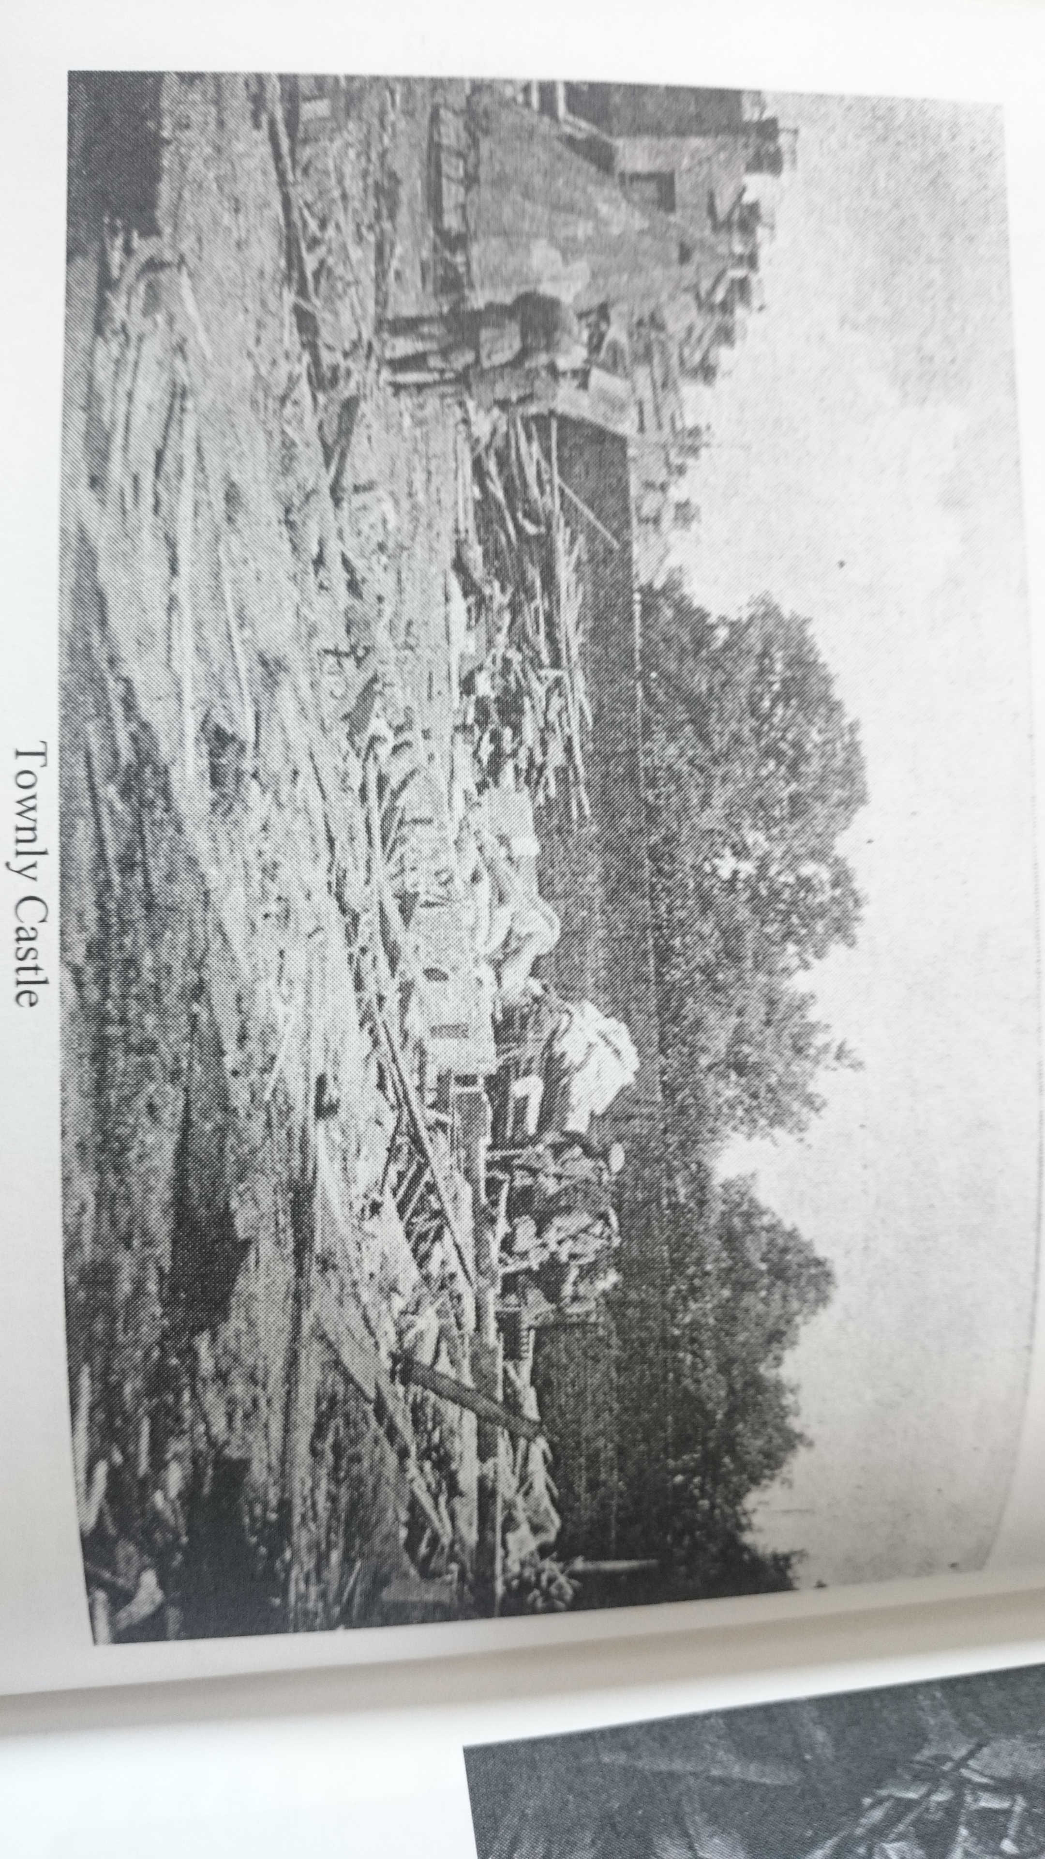

Slide 3
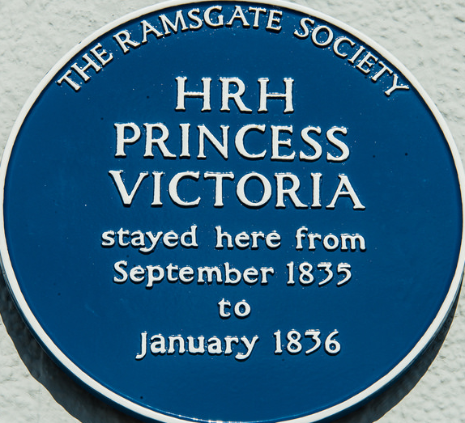
Why does this deserve the awarding of a Blue Plaque from the Ramsgate Society?
We believe this deserves a blue plaque primarily out of memory for those that were killed or injured during the raids
The role of the school and the events that occurred there are not common knowledge and having a blue plaque would enable the public to learn about the significance of the school in The Great War and continue the memory of those that were there over 100 years ago
We felt it appropriate seeing as the centenary of the armistice is approaching and the 101st anniversary of the bombing raid is almost a month away
The raid that occurred here on 22nd of August 1917 was the last daylight raid on England of WW1
Ramsgate was the most heavily bombed town in England during The Great War

Slide 4
Special Thanks
Special thanks must be given to the following:
Mr. De Paolis, for his help and offers of assistance in retrieving essential information that without would have made this project immeasurably harder
Mr. Freeman, who has given us access to original documents and invaluable information
The Reference Department of Ramsgate Library where more information can be found

