Slide 1
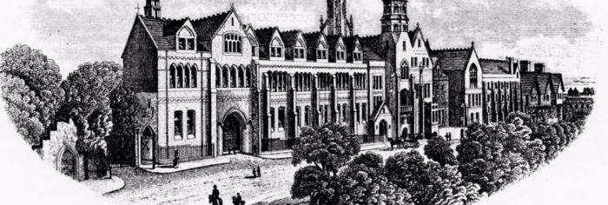
Blue Plaque entry – Chatham house grammar school Ramsgate for the memory of those killed In the great war
By Liam East, Charlie Graham and Gayain Thomas

Slide 2
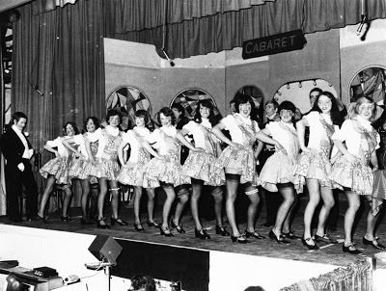
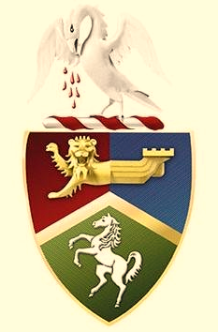
A Brief History of Chatham House
Chatham House as a formal school situated at this site was founded in 1797 by Dr. William Humble, the site was then taken over by Thomas Whitehead in 1817 and later by his son Alfred in 1854; who was the curate of St. George’s Church.
Upon his elevation to becoming vicar of St. Peter's, Alfred was succeeded as headmaster by Reverend Thomas Stantial in 1864, who in turn was succeeded upon his retirement in 1874 by Reverend Edward Gripper Banks.
Under the guidance of ‘Gripper’ Banks the school underwent huge changes, with chemistry labs built. The reputation of the school continued to expand and in 1879 the foundation stone for the current ‘red brick’ building was laid, which was then completed in 1882. In 1884 the school grounds were greatly expanded with the purchase, from the Townley Castle Estate, of the seventeen acres adjoining. This established the general shape and grounds of the modern day site.
(information from the Chatham and Clarendon Grammar School website)

Slide 3
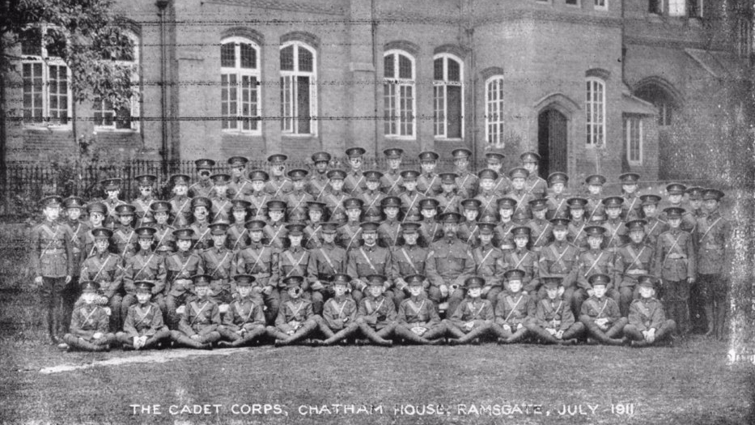
The School’s role during The Great War
During The Great War, the school continued to function up until early 1916 when the school was evacuated to Gloucester and the premises requisitioned as a Canadian Military Hospital
The hospital was based over both the Chatham House site and Townley Castle site
Townley Castle was for the more severely injured personnel
The hospital was managed by the Voluntary Aid Detachments’ (VAD’s for short)

Slide 4
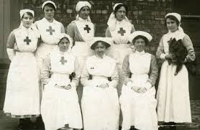
VADs
County branches of the Red Cross had their own groups of volunteers called Voluntary Aid Detachments (often abbreviated to VAD). Voluntary Aid Detachment members themselves came to be known simply as ‘VADs’.
Made up of men and women, the VADs carried out a range of voluntary positions including nursing, transport duties, and the organisation of rest stations, working parties and auxiliary hospitals.
A “general service” section of the VADs was established in September 1915. As men went off to fight VADs were supplied in their place, carrying out their roles such as dispensers, clerks, cooks and storekeepers.

Slide 5
Roll of honour
The school itself played a role with a significant number of teachers, students and former students going off to join the fight, unfortunately many of which did not return.
These are the young men who joined active service from Chatham during The Great War
Sadly most of those shown were killed
It is also worth noting that Admiral W.B. Fisher attended the school before progressing through the military

Slide 6
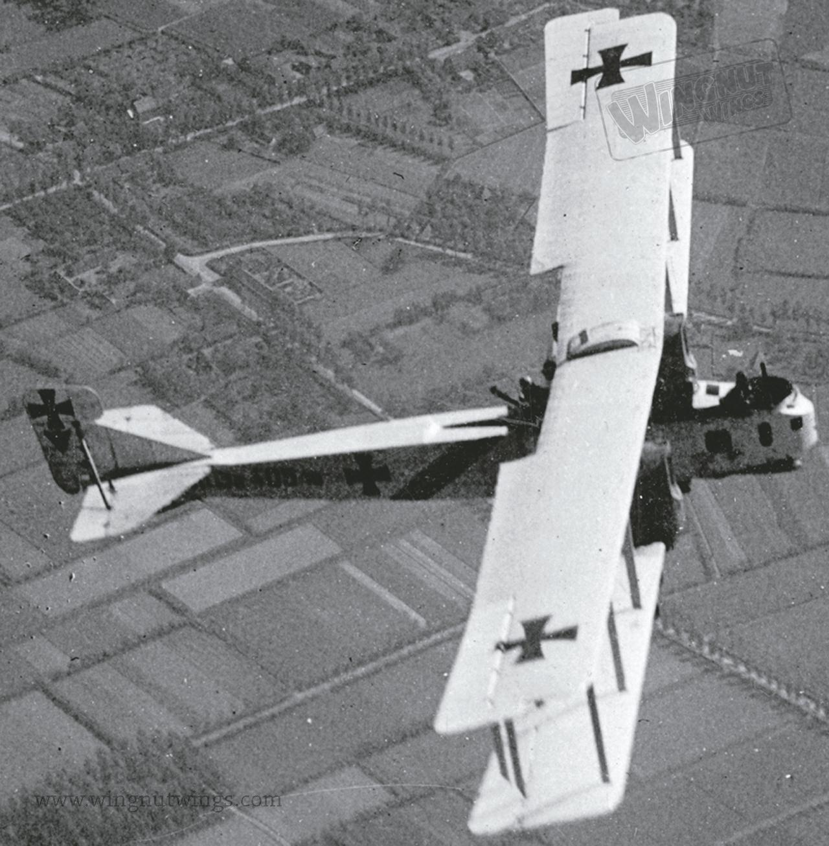
22nd of August 1917
On the 18th of August an attempted raid by a squadron of Gotha G.IV bombers was made but atmospheric conditions meant it could not take place so on the 22nd of August another raid was launched with more success
The aircraft were spotted over the channel by a lightship and a subsequent Royal Flying Corps response was sent out from Manston to intercept
Some of the Gotha's were brought down by the RFC pilots in Sopwith Pups and Camels and one is believed to have been destroyed by anti aircraft fire
With just eight aircraft remaining, the raid on the Thames and Medway was abandoned and instead the raid was held on Thanet. The bombers then turned south, dropping thirty-four bombs, seven of which were duds, on Ramsgate, killing nine and injuring twenty-two.

Slide 7
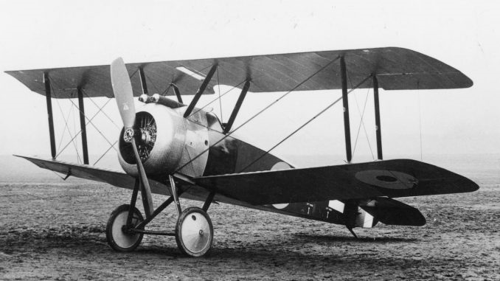
Chatham House on 22nd August
Chatham House and Townley Castle Schools, which were being used at the time as hospitals for Canadian wounded soldiers, were amongst the big buildings chosen as targets by the enemy
In the grounds of Townley Castle several tents and corrugated buildings used by the staff were reduced to debris.
At Chatham House, where a more direct hit was achieved, a bomb fell on the main roof and fell through the chapel but did not explode until it reached a large room in the basement.
There were 2 fatal victims of this blast at the school and 5 injured persons
1 of the dead was a Canadian Butcher who it was said, as was described in a diary (in Ramsgate Library), was “cut in half by the blast”

